Slide 1

Your Ultimate SQL Server Statistics Best Practices Review
SELECT "About me:"
FROM (VALUES('Fabiano Neves Amorim'),
('Data Platform MVP'),
('fabianonevesamorim@hotmail.com | @mcflyamorim'),
('Principal Consultant – Pythian(Love your data)'),
('http://blogfabiano.com')) AS Tab("About me:")
SQL Saturday Boston 2023 (#1046)

Slide 2
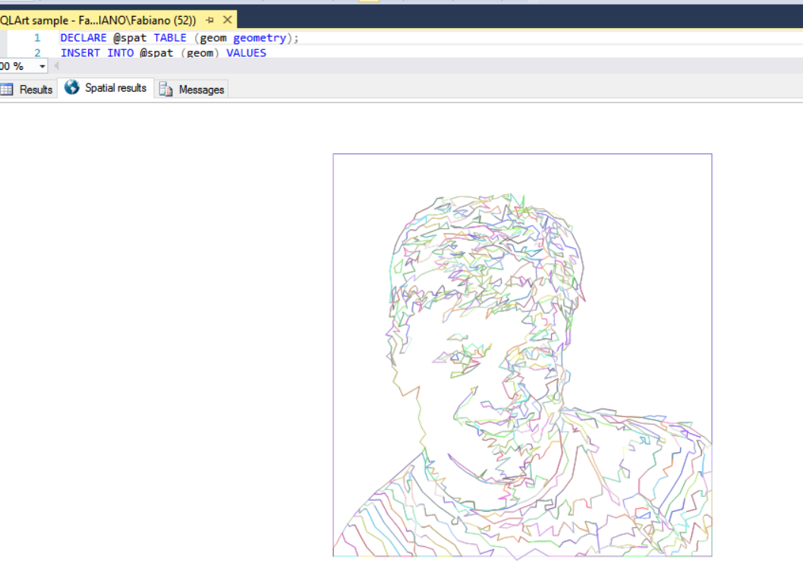


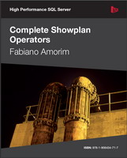






About me
Microsoft Data Platform Internal Principal
Consultant at Pythian (Ottawa)
Microsoft Data Platform MVP since 2011
Books
https://www.youtube.com/user/mcflyamorim
twitter.com/mcflyamorim
linkedin.com/in/fabianoamorim
blogfabiano.com
fabianonevesamorim@hotmail.com

Slide 3









Thank You! Sponsors

Slide 4



Overview - Statistics
“Statistics show every two minutes another statistic is created.” (Anonymous)
Query optimization is not easy
Statistics form the basis for a query optimization
Statistics help the query optimizer in choosing appropriate
execution plans to improve performance
You should consider to review SQL statistics in the
following conditions:
1 - Query execution time is slow (luckily not a very common scenario right ? ;P)
github.com/mcflyamorim/statisticsreview

Slide 5
Importance of a review
“There are three kinds of lies: lies, damned lies, and statistics.” (Leonard Courtney)
Before performing any performance troubleshooting step,
the first thing you should do is to ensure that QO (Query Optimizer)
was able to create a high-quality query plan.
To increase chances of a high-quality plan, you should ensure the following:
Accurate CE (Cardinality Estimations).
Useful and up-to-date statistics about your data distribution.
CE in SQL is derived primarily from statistics, therefore, to make
sure you generate optimal query plans, it is best to design queries
so that the QO can accurately estimate the selectivity of the
conditions in your query, and, ensure you have up-to-date statistics.
This will increases chances of a more precise CE and,
in turn, faster execution plans.
github.com/mcflyamorim/statisticsreview

Slide 6
History behind the code
“First get the facts, then you can distort them as much as you want” (Mark Twain)
I always thought my “scripts” folder was enough to collect all the information I needed to validate the statistics in a instance. In this folder I had precious scripts like: sp_blitz, Glenn Berry's diagnostic queries, Tiger’s team BP check and Kimberly Trip’s scripts and etc.
The more I was studying and working on this subject, more I was understanding how much this is important and how difficult it was to cover “all possible” scenarios.
I decided to work on a automation to produce a report to help SQL users to check a instance for some of most common skewed best practices and performance issues related to statistics.
github.com/mcflyamorim/statisticsreview

Slide 7

How it works
“First get the facts, then you can distort them as much as you want” (Mark Twain)
Collect information about statistics
Run check based on stats usage info
Save results in a Excel report
Stored procedure - sp_GetStatisticInfo
.sql files on folder IndividualChecks
Excel spreadsheet with result of all checks and a summary
github.com/mcflyamorim/statisticsreview

Slide 8
Comments and notes
“First get the facts, then you can distort them as much as you want” (Mark Twain)
Download on my git-hub: github.com/mcflyamorim/statisticsreview
Currently running 58 checks (I’m planning to add a few more).
Summary spreadsheet with some insights based on check results.
PS modules: SqlServer to run .sql scripts and ImportExcel to generate the Excel report.
Using unsupported TFs 2388 and 8666 to return more information about stats.
Although those are well known TFs and are around for a while, you know, they’re not supported by MS, so, I feel obligated to say, be careful.
Doesn’t work on cloud because it requires TFs to be enabled (I’m planning to work to support this)
References: Hugo Kornelis, Brent Ozar, Erin Stellato, Paul White, Kimberly Tripp,
Tiger team, Joe Sack, Kendra Little and probably a lot other people I forget, thank you SQL Community.
github.com/mcflyamorim/statisticsreview

Slide 9
Sample of available checks
Check4
Stats and sort warning
Check3
High compilation time
Check 13
TF4199
Check39
Missing column stats
Check34
Stats full to sample
Check41
Auto Created multicol
Check53
Plans with high mod count
Check15 and Check47 (Data skew histograms)
Check20
Inc. partitioned stats
github.com/mcflyamorim/statisticsreview

Slide 10
Current list of checks
Check1-Stats history
Check2-Estimate upd stat freq
Check3-High compilation time
Check4-Stats and sort warning
Check5-Unused stats
Check6-Estimate mod per min
Check7-Upd stat threshold
Check8-Tiny tab OutOfDate
Check9-TF2371 dynamic threshold
Check10-Ascending stats
Check11-TF4139 hist amendment
Check12-TF2389 and TF2390 hist
Check13-TF4199 - QO hotfixes
Check14-Filtered stats
Check15-Data skew histograms
Check16-Filtered stat OutOfDate
Check17-NoExpand stats on views
Check18-DB setting
Check19-Inc. DB setting
Check20-Inc. partitioned stats
Check21-Async, background jobs
Check22-Modules running upd
Check23-Small percent sample
Check24-Adjust MAXDOP
Check25-NoRecompute
Check26-Stats on LOB columns
Check27-More stats than cols
Check28-Duplicated stats
Check29-Tables 10mi and sample
Check30-Out-of-date stats
Check31-Empty histograms
Check32-TF7471 parallel UpdStat
Check33-Persist_Sample_Percent
Check34-Stats full to sample
Check35-Hypothetical stats
Check36-Data from CommandLog
Check37-Sample on part. tab
Check38-Anti-matter columns
Check39-Missing column stats
Check40-Missing multi-col stats
Check41-AutoCreated multicol
Check42-SampleRate per table
Check43-Search maintenance plan
Check44-Auto_Stats xEvent
Check45-Stats load and linked
Check46-Bad internal stat order
Check47-Data skew histograms 2
Check48-Clustered columstore
Check49-Cloned DB columstore
Check50-Bad leading column
Check51-Maintenance time win
Check52-PlansWithLotStats
Check53-PlansHighModCount
Check54-Queries with distinct
Check55-Plan cache usage
Check56-Date info
Check57-Ascii graph histogram
Check58-Table growth

Slide 11
Sample of question/answers you can get from the report
Number of out-of-date (more than 24 hours since last update) stats
Percent of stats considered out-of-date (more than 24 hours since last update)
Number of tiny table (less than or equal to 500 rows) with out-of-date stats
Number of estimated events of stats being updated from fullscan to sample(due to an auto-update)
Number of duplicated stats
Number of unused stats
Number of tables with more stats than columns
Number of stats on LOBs (Large Objects) or BLOBs (Binary Large Objects)
Number of stats using static auto-update threshold
Number of partitioned tables that will have a sample rate in a index rebuild
Number of ascending/descending stats
Number of stats with a histogram step with a RANGE_ROWS greater than 50% of rows in the histogram
Number of stats with a histogram step with a EQ_ROWS greater than 50% of rows in the histogram
Number of stats with a histogram step indicating that a NULL represents more than 10% of all rows in the histogram
Number of stats with an unecessary(with no modifications) update
Number of stats with an event of update with interval of less than 15 minutes
Number of stats with an event of update with interval greater than 25 hours
Number of stats with an auto-update about to be triggered
Number of long query plan compilation/optimization time due to an auto update/create stats
Number of statistics with wrong metadata order
Number of DBs with partitioned tables, but not set to use incremental stats
Number of multi-column stats with a bad leading column
Number of indexed views referenced in a module without noexpand query hint
Number of modules manually running "update statistics"
Number of plans with more than 50 loaded stats
Found a maintenance plan job?
Number of good candidates for a filtered stats

Slide 12
All question/answers you can get from the report
Number of out-of-date (more than 24 hours since last update) stats
Percent of stats considered out-of-date (more than 24 hours since last update)
Number of tiny table (less than or equal to 500 rows) with out-of-date stats
Number of stats with a sampling rate lower than 5% of table
Number of tables that will have an auto update/create sampling rate lower than 5% of table
Number of estimated events of stats being updated from fullscan to sample(due to an auto-update)
Number of statistics with modifications greater than 1000 or 1% of table
Number of stats with only 1 update since creation
Number of duplicated stats
Number of unused stats
Number of missing multi-column stats
Number of multi-column stats auto created on SQL 2000
Number of missing column stats events from default trace
Number of hypothetical stats
Number of stats with empty histograms
Number of tables with more stats than columns
Number of stats on LOBs (Large Objects) or BLOBs (Binary Large Objects)
Number of stats using static auto-update threshold
Number of stats on partitioned tables not using incremental stats
Number of partitioned tables that will have a sample rate in a index rebuild
Number of ascending/descending stats
Number of filtered stats
Number of good candidates for a filtered stats
Number of filtered stats considered out-of-date
Number of stats with "skewed" histograms causing bad cardinality estimation
Number of stats with a histogram step with a RANGE_ROWS greater than 50% of rows in the histogram
Number of stats with a histogram step with a EQ_ROWS greater than 50% of rows in the histogram
Number of stats with a histogram step indicating that a NULLs represents more than 10% of all rows in the histogram
Number of stats with an unecessary(with no modifications) update
Number of stats with an event of update with interval of less than 15 minutes
Number of stats with an event of update with interval greater than 25 hours
Number of stats with an estimated auto-update frequency of less than 1 hour
Number of stats with modifications greater than the average of all objs
Number of stats with an auto-update about to be triggered
Number of stats with modifications greater than auto-update threshold
Number of long query plan compilation/optimization time due to an auto update/create stats
Number of statistics with wrong metadata order
Number of tables with clustered ColumnStore indexes that may report wrong number of modifications
Number of sort spilled to tempdb due to an auto update/create stats
Number of DBs with auto-update-stats disabled
Number of DBs with auto-create-stats disabled
Number of DBs using auto-create-stats-async, but with auto-update stats disabled
Number of DBs with partitioned tables, but not set to use incremental stats
Number of multi-column stats with a bad leading column
Number of indexed views referenced in a module without noexpand query hint
Number of auto-update stats async pending on background job queue
Number of modules manually running "update statistics"
Number of plans with more than 50 loaded stats
Number of plans with loaded statistics with high modification count greater than 1k
Found a maintenance plan job?
Is there an extended event tracking Auto_Stats event?
Trace flag 2371 usage should be considered
Trace flag 4139 usage should be considered
Trace flags 2389 and 2390 usage should be considered
Trace flag 4199 usage should be considered
Trace flag 7471 usage should be considered
Number of stats using "persist sample percent"
Number of stats set to NoRecompute

Slide 13
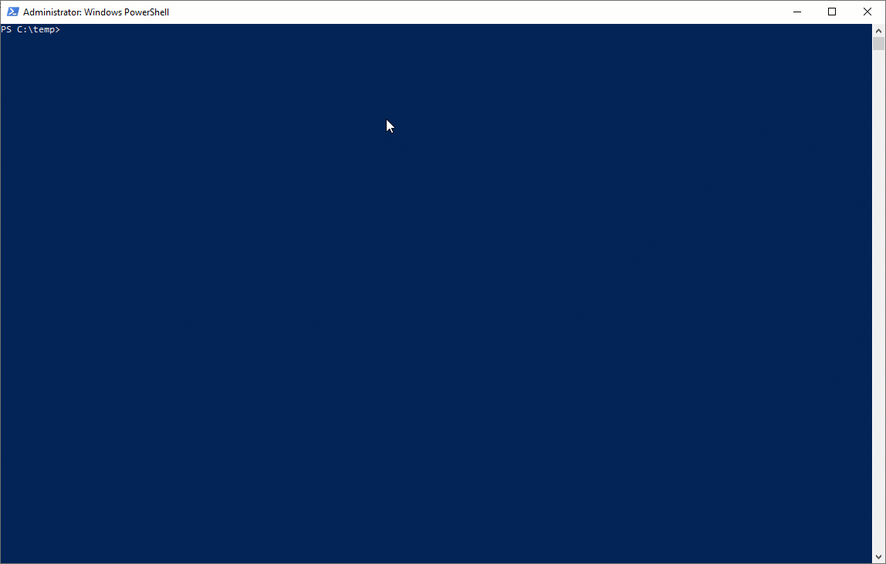
Demo time
Check48 – Clustered Columnstore
Check 13 - TF4199
Check47 and Check57 (skewed histograms)
Bonus – Check58 – Table growth
Check41 – Auto created multicol
Check55 – Plans cache usage
Demo1 - Run analysis – Excel Report
Check34 - Stats full to sample
Check3 - High compilation time
github.com/mcflyamorim/statisticsreview

Slide 14
Quick tips and most common issues
“First get the facts, then you can distort them as much as you want” (Mark Twain)
Maintenance not running frequently enough or no maintenance at all
Statistics on LOB taking most of time of maintenance window
Duplicated statistics
Auto created multi-column stats
Stats with small sample size
Stats using static auto update threshold
Skewed histograms
Multi-column stats with bad leading column
From full to sample due to automatic update
Partitioned tables – Rebuild = sample and not using incremental
github.com/mcflyamorim/statisticsreview

Slide 15

Q&A Don’t forget to fill out the evaluation.
SELECT "About me:"
FROM (VALUES('Fabiano Neves Amorim'),
('Data Platform MVP'),
('fabianonevesamorim@hotmail.com | @mcflyamorim'),
('Principal Consultant – Pythian(Love your data)'),
('http://blogfabiano.com')) AS Tab("About me:")
?

